Slide 1
Real Algorithm
Just started

Slide 2
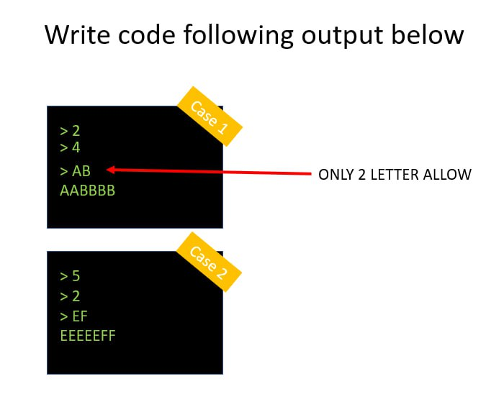

Slide 3
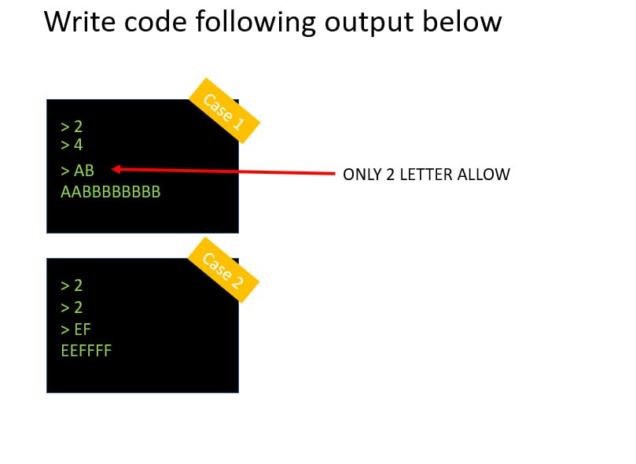
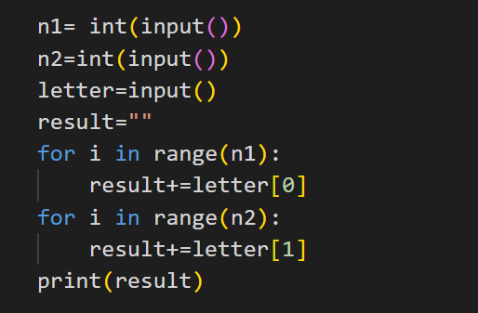
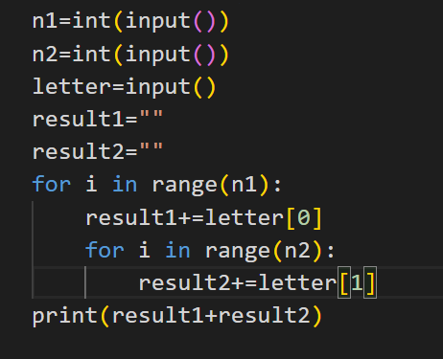

Slide 4
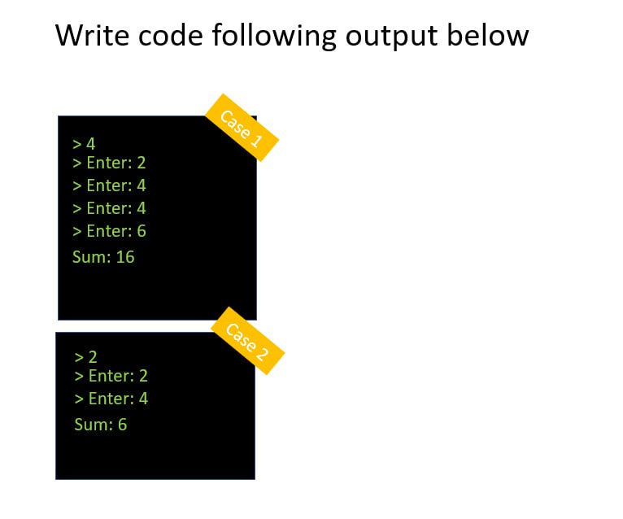
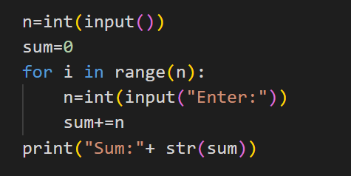

Slide 5
Algorithm
STEP TO SOLVE PROBLEM
STEP1: ANALYS INSTRUCTION (UNDERSTAND INSTRUCTION)
STEP2: DRAW FLOW CHAT TO UNDERSTAND CODE FLOW
STEP3: WRITE CODE

Slide 6
TRY TO WRITE CODE FOLLOWING FLOWCHAT
N = 0
REPEAT<10>
IF N > 10
FALSE
PRINT(“OK”)
PRINT(“Hello”)
TRUE
PRINT(“Hello”)

Slide 7
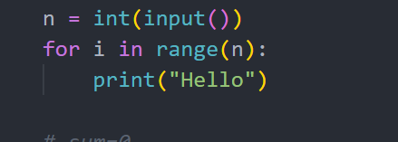
Write code following output below
Case 1
N = INPUT
> 2
Hello
Hello
>
REPEAT<N>
Case 2
> 5
Hello
Hello
Hello
Hello
Hello
>
PRINT(“Hello”)

Slide 8
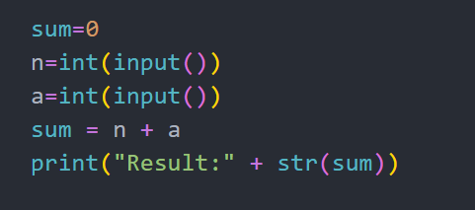
Write code following output below
Case 1
> 2
> 4
Result: 6
>
Case 2
> 5
> 8
Result: 13
>

Slide 9
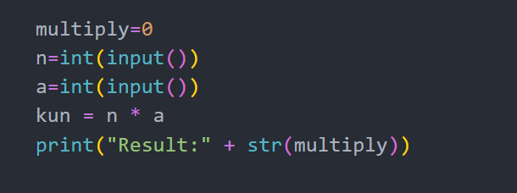
Write code following output below
Case 1
> 2
> 4
Result: 8
>
Case 2
> 5
> 8
Result: 40
>

Slide 10
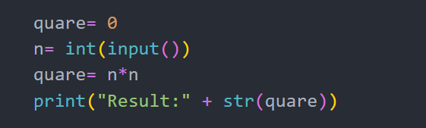
Write code following output below
Case 1
> 2
Result: 4
>
Case 2
> 5
Result: 25
>

Slide 11
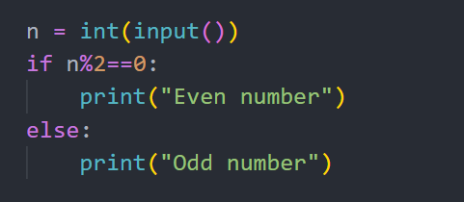
Write code following output below
Case 1
> 2
Even number
>
Case 2
> 5
Odd number
>

Slide 12
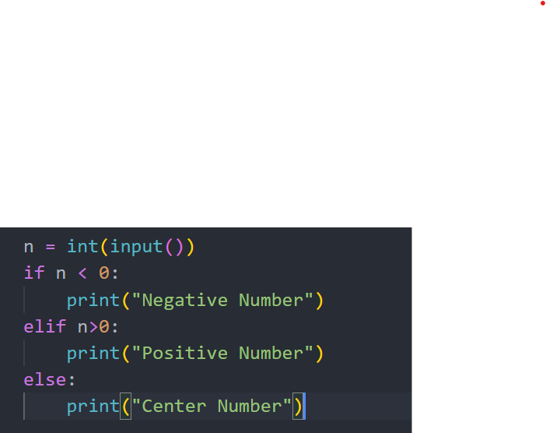
Write code following output below
Case 1
> -2
Negative number
>
Case 2
> 5
Positive number
>
Case 3
> 0
Center number
>

Slide 13
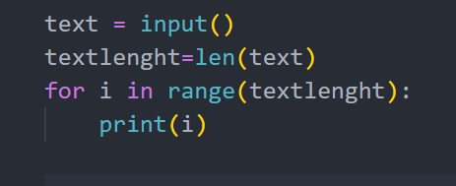
Write code following output below
Case 1
> Hello
0
1
2
3
4
>
> hi
0
1
>
Case 2

Slide 14
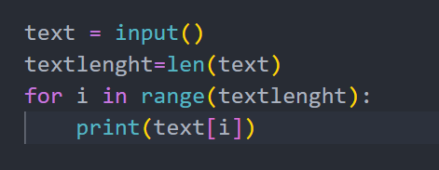
Write code following output below
Case 1
> Hello
H
e
l
l
o
>
> hi
h
i
>
Case 2

Slide 15
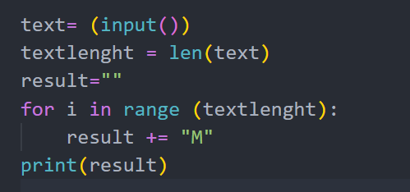
Write code following output below
Case 1
> Hello
MMMMM
>
> hi
MM
>
Case 2

Slide 16
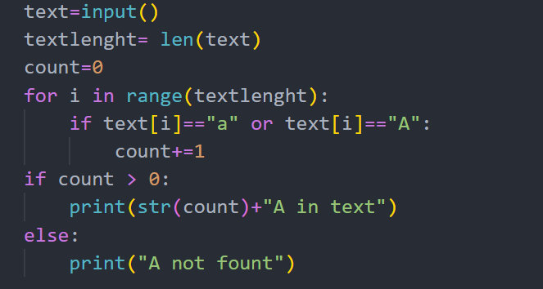
Write code following output below
Case 1
> Hello
A not found
>
> Banana
3 A in text
>
Case 2

Slide 17
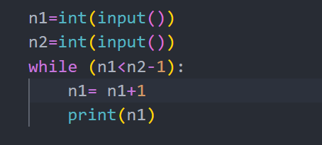
Write code following output below
First number must be lower than second number
Case 1
> 1
> 4
2
3
>
Case 2
> 3
> 9
4
5
6
7
8
>

Slide 18
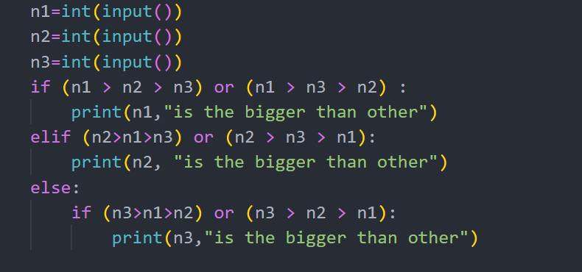
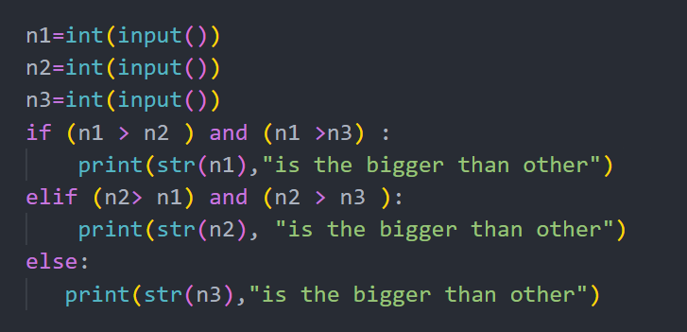
Write code following output below
Case 1
> 1
> 4
> 8
8 is bigger than other
>
Case 2
> 3
> 9
> 6
9 is bigger than other
>

Slide 19
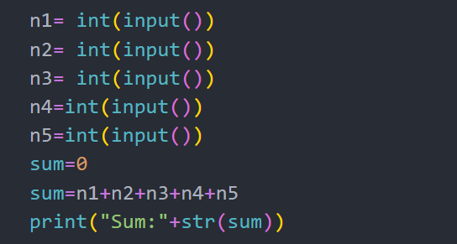
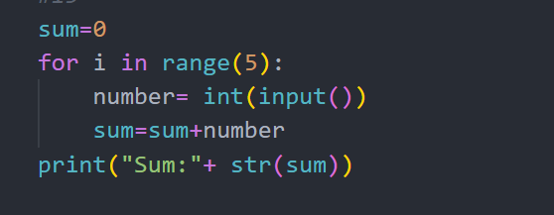
Write code following output below
Enter 5 times and sum all numbers
Case 1
> 1
> 4
> 8
> 3
> 2
Sum: 18
>
Case 2
> 1
> 1
> 2
> 3
> 6
Sum: 13
>

Slide 20
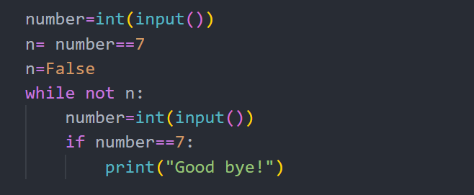
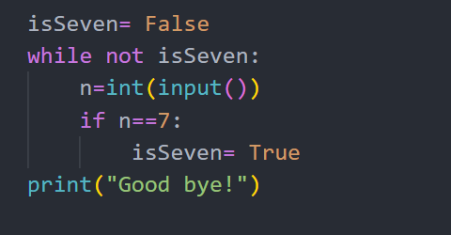
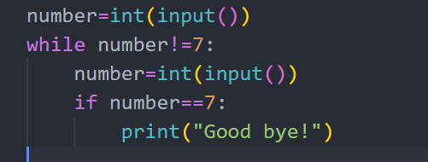
Write code following output below
Enter until find number 7
Case 1
> 1
> 4
> 8
> 3
> 7
Good bye!
>
Case 2
> 1
> 1
> 7
Good bye!
>

Slide 21
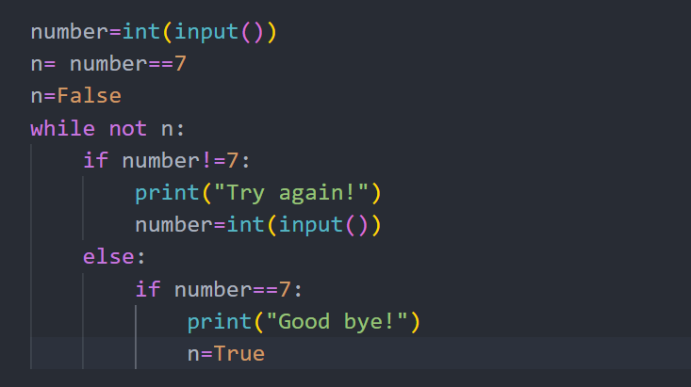
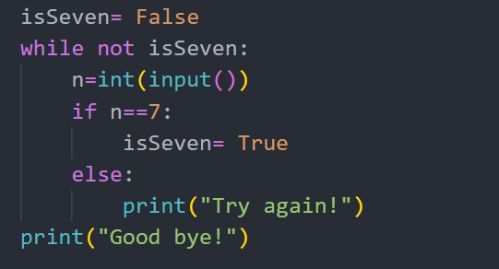
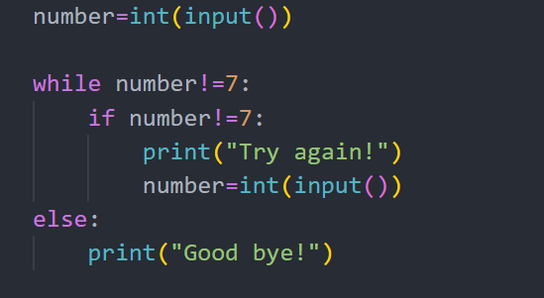
Write code following output below
Enter until find number 7 display “Good bye!” otherwise display “Try again!”
Case 1
> 1
Try again!
> 3
Try again!
> 7
Good bye!
>
Case 2
> 1
Try again!
> 7
Good bye!
>

Slide 22
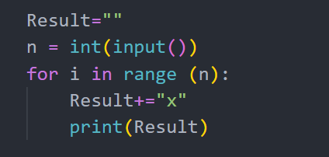
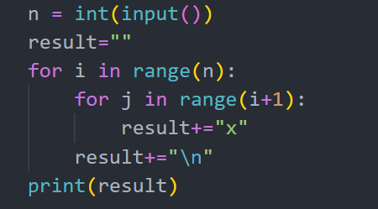
Write code following output below
Case 1
> 4
x
xx
xxx
xxxx
Case 2
> 2
x
xx

Slide 23
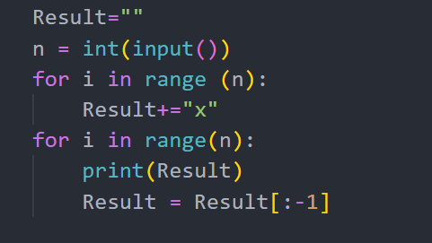
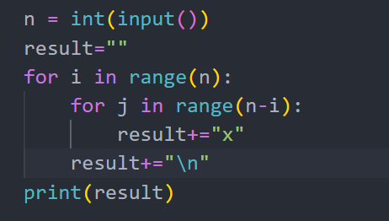
Write code following output below
Case 1
> 4
xxxx
xxx
xx
x
Case 2
> 2
xx
x

Slide 24
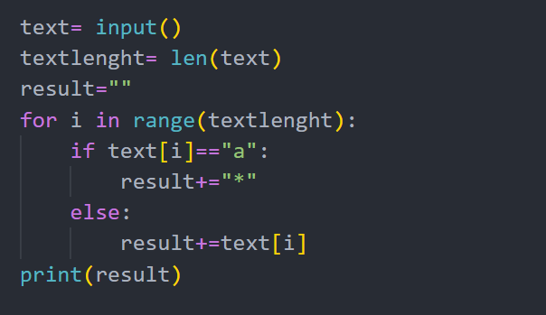
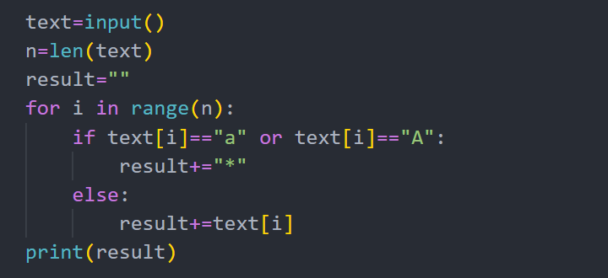
Write code following output below
Case 1
> abababa
> *b*b*b*
Case 2
> acdefgaca
> *cdefg*c*

Slide 25
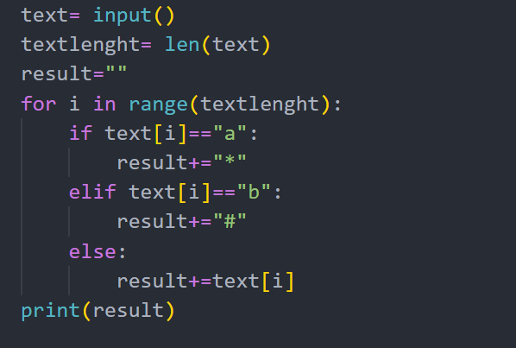
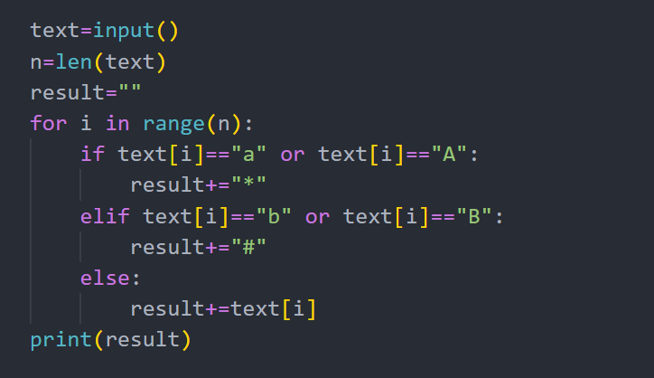
Write code following output below
Case 1
> abacdef
> *#*#cdef
Case 2
> acbefbaca
> *c#ef#*c*

Slide 26
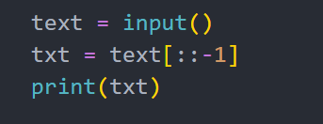
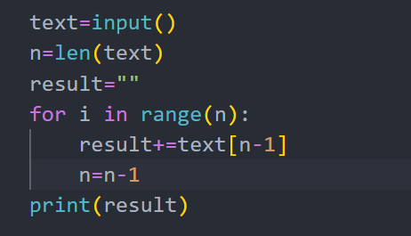
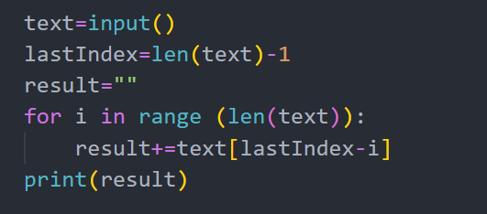
Write code following output below
Case 1
> hello
> olleh
Case 2
> hi
> ih

Slide 27
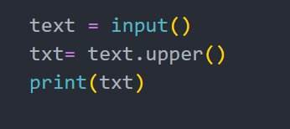
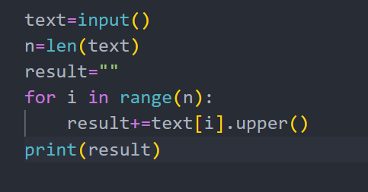
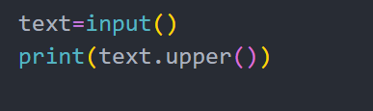
Write code following output below
Case 1
> hello
> HELLO
Case 2
> HI
> HI

Slide 28
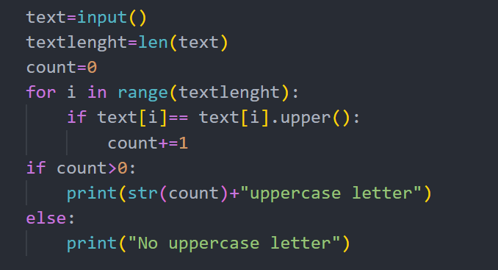
Write code following output below
Case 1
> hello
No uppercase letter
Case 2
> HI
2 uppercase letter

Slide 29
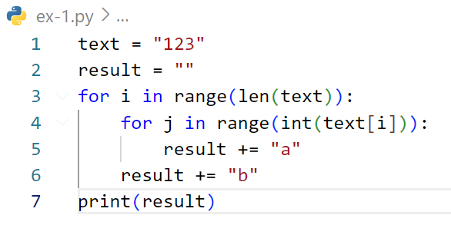
Find output of code below
abaabaaab

Slide 30
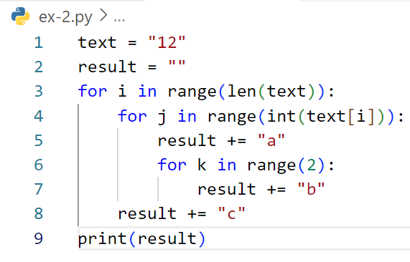
Find output of code below
abbcabbc

Slide 31
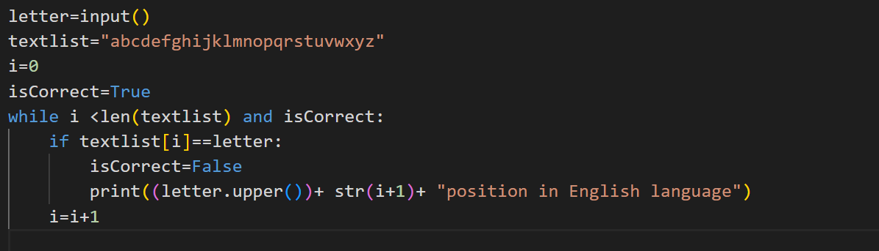
Write code following output below
Case 1
> a
A position 1 in English Language
Case 2
> h
H position 8 in English Language

Slide 32
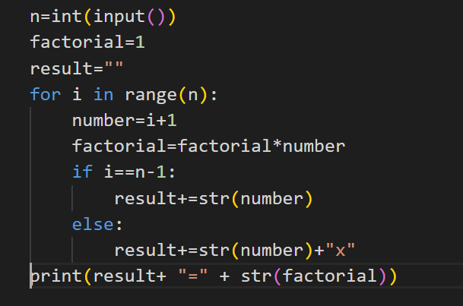
Write code following output below
Case 1
> 2
1 x 2 = 2
Case 2
> 4
1 x 2 x 3 x 4 = 24

Slide 33
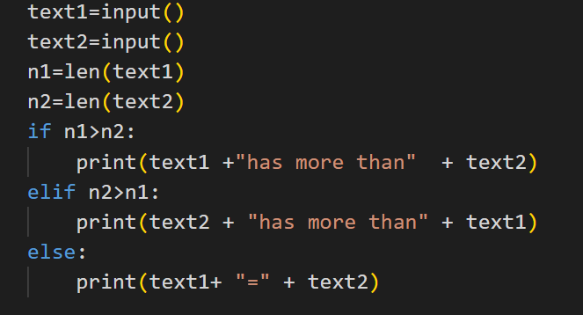
Write code following output below
Case 1
> Rady
> Yon
Rady has more letter than Yon
Case 2
> Tanguy
> Rady
Tanguy has more letter than Rady

Slide 34
Write code following output below
Case 1
> Rady
> Yon
Rady has more letter than Yon
Case 2
> Tanguy
> Rady
Tanguy has more letter than Rady

Slide 35
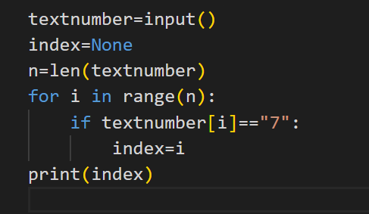
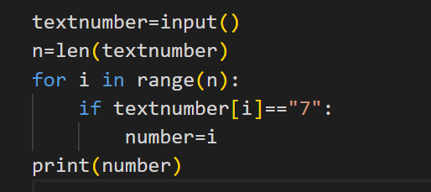
Write code following output below
string
Case 1
> 123456789
Last 7 is index: 6
string
Case 2
> 97871718
Last 7 is index: 5

Slide 36
Write code following output below
string
Case 1
> 123456789
Last 7 is index: 6
string
Case 2
> 97871718
Last 7 is index: 5

Slide 37
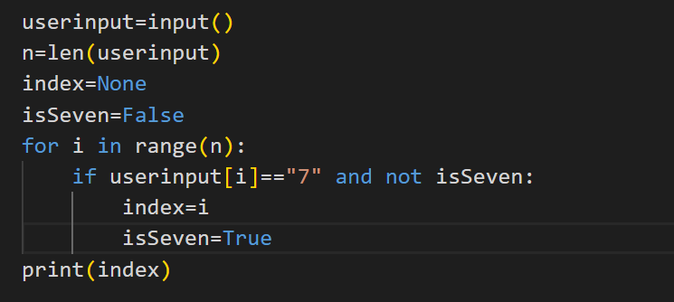

Write code following output below
string
Case 1
>
First 7 is index: 2
string
Case 2
> 97871718
First 7 is index: 1

Slide 38



Slide 39



